Slide 1
Movie Genres and Popularity
James Avery, Andrew McGraw, Cade Schkerke

Slide 2
Motivations
What genre of movie resonates the most with people and in what combinations?
On what months do you see the most popular genres?
Looking at the month with the most popular movie, what genres were most popular?

Slide 3
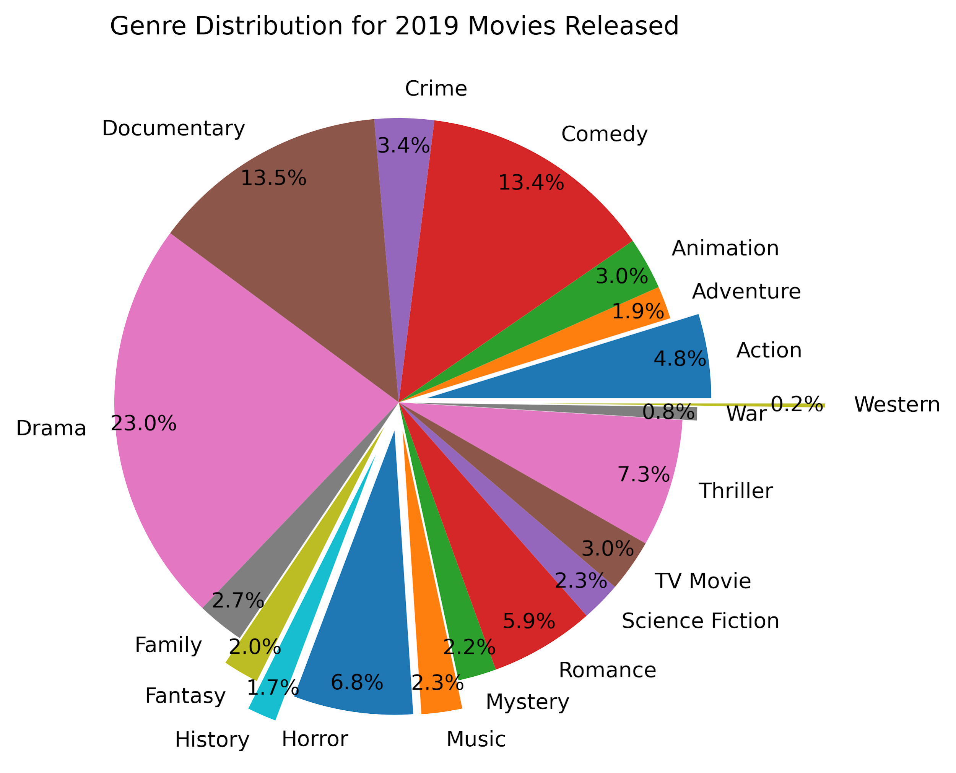

Slide 4

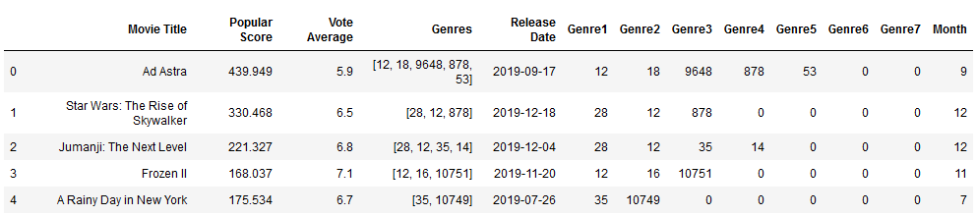
Data Exploration and Cleanup
We built our data set by calling on an API named TheMovieDB (TMDb). The responses are sourced from IMDb data, and some custom measurements the API team created and manages.
The base Movies dataframe we created and sourced our later findings on from the API responses

Slide 5
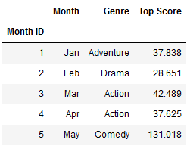
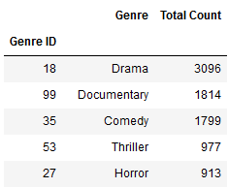
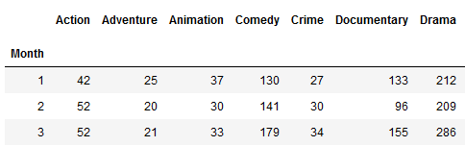
Data Exploration (cont.)
We created a few new dataframes to hold newly defined, calculated, or filtered data.
We used these refined dataframes to answer our questions, confirm or deny suspicions about the data, and as a basis for our future visualizations.
We sourced all of our data from the primary Movie dataframe we created from API data.

Slide 6
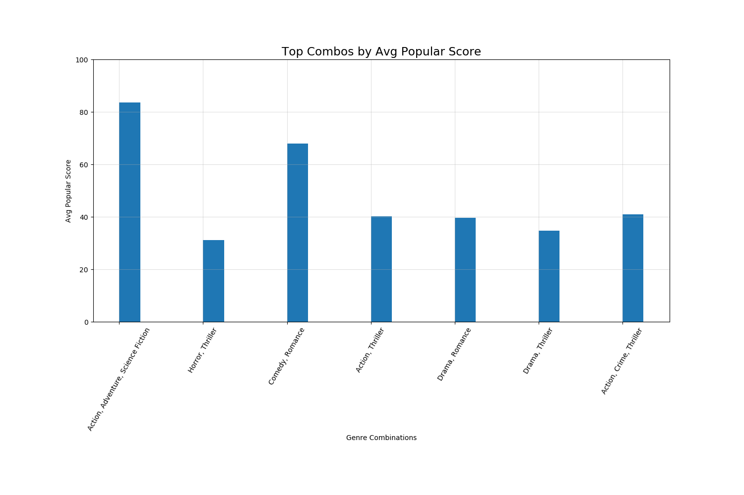
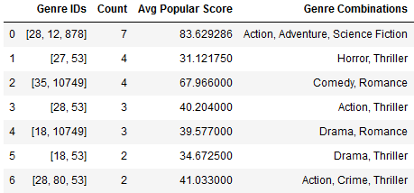
Which combinations are the most effective?
Created a dataframe to count the most frequent genre combinations found within the top 100 movies.
From there, we calculated the average Popular Score for these combinations, and created a bar chart to visualize the scores for each.
It appears that on average, the combination of Action, Adventure, and Science Fiction is the most effective with the highest Popular Score.

Slide 7
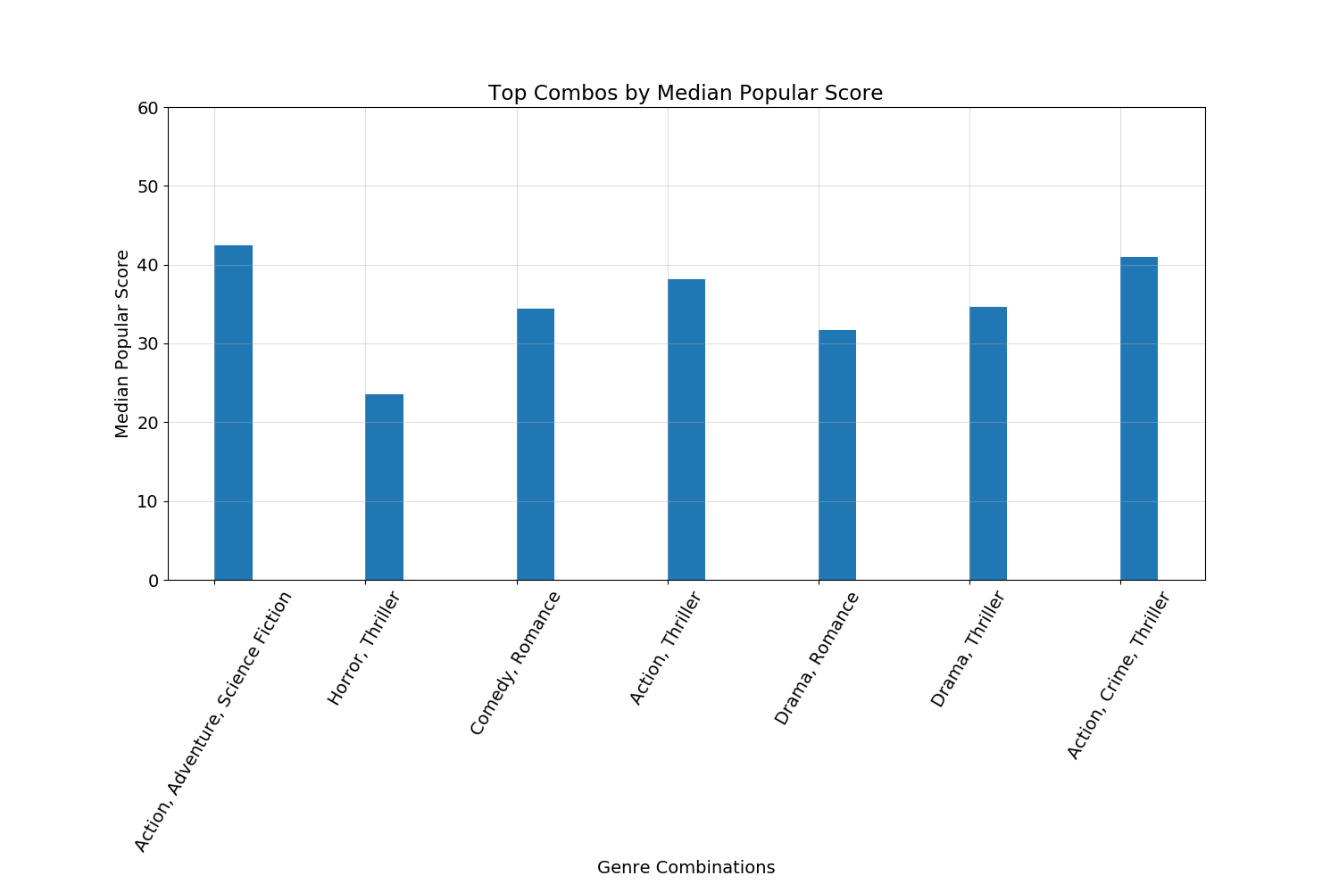
Top Combos by Median
Median Scores per Top Genre Combinations shows the same top two, but with different scores

Slide 8
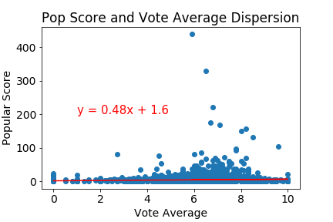
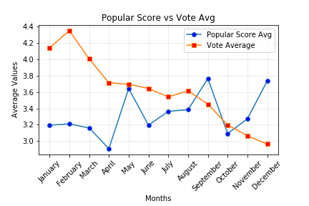
Popular Score vs Vote Average: Pattern?
Popular score: Number of votes for the day, number of views for the day, number of users who favorited the movie that day, how often it was added to a “watchlist”, release date, and previous day’s score.

Slide 9
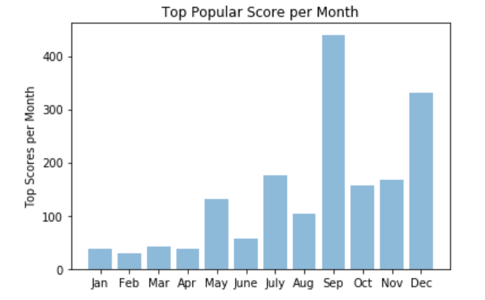
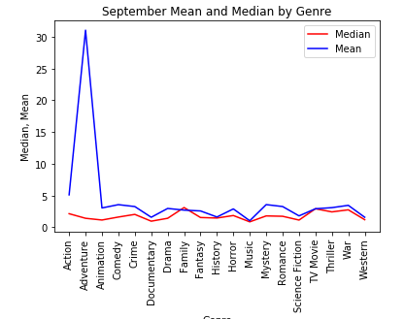

Which Month has the Best Individual Score?
Top individual score for each month.

Slide 10
Other Considerations
These values are constantly updating via the API. Constant running of code needed to get most up to date information. A dashboard of some sorts would be a good idea.
Flattening the list of genres returned by the API and iterating through the result is based on a set amount of current genres, if new genres were added it could cause issues with the accuracy of our data and conclusions. Adjusting code for potential changes to the API sourcing would be ideal for future versions.

Slide 11
Conclusions
September had the highest individual movie popular score. Within the month of September, the highest average score was for Adventure, but the highest median score was for Family.
Action, adventure, and science fiction was the best performing combination of genres.
Average vote score changes at a more consistent rate when compared to the average popular score. However, popular score is a better representation of the general public opinion.

